Slide 1
Deception Detection
Kanak Yadav Garvit Singh Sayantan Das Gupta
Group -54
NLP Final project

Slide 2
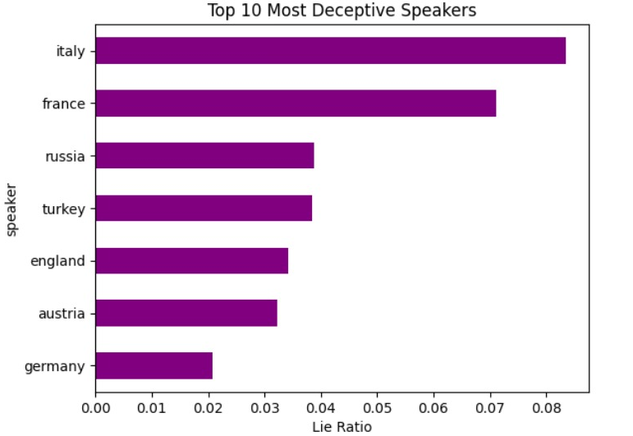
Introduction
Understanding Deception in Strategic Conversations
Trust underpins online interactions, yet deception is common in digital contexts (e.g., spearphishing, dating, sockpuppetry).
Traditional deception studies focus on short, isolated utterances with limited context or motivation.
This study introduces a novel dataset from the game Diplomacy—a negotiation-based board game requiring strategy, trust, and betrayal.
Objective: Examine the language and social dynamics of deception in long-form, high-stakes conversations.
Key innovation: Captures both sender’s intent and receiver’s perception of lies in context-rich environments.
Human lie detection is imperfect; machine learning models are trained to approximate or exceed this capability.

Slide 3
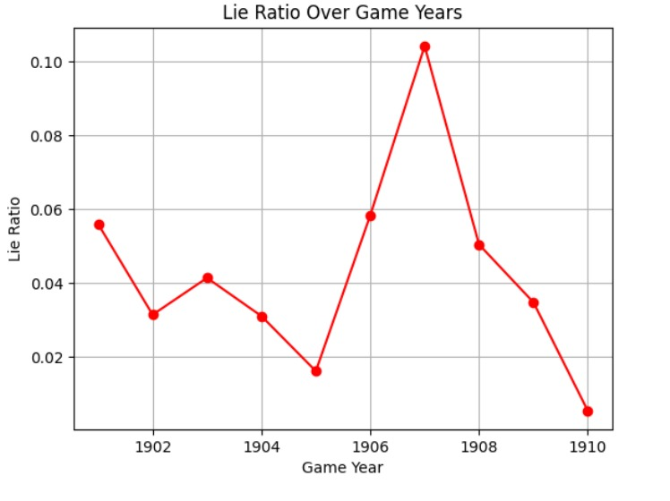
Literature review
Existing deception detection focuses on:
Crowdsourced or synthetic short statements (e.g., fake news headlines, interviews).
One-off deception events without context or strategic motivation.
Role-bound deception (e.g., games like Werewolf where some players must lie throughout).
Dynamic deception: Players choose when and whom to deceive based on strategic goals.
Dual annotation:
Senders label intent (ACTUAL LIE).
Receivers label perception (SUSPECTED LIE).
Rich conversational context: Long-form dialogues, multi-turn interactions, evolving trust dynamics.
Power-aware communication: Uses game mechanics (e.g., army strength, victory points) to quantify power imbalances and influence deception patterns.
Positioning: Bridges the gap between short utterance-based datasets and real-world, high-context strategic conversations.
Sets a new benchmark by offering deception annotations with both intent and perception in multi-party negotiations.

Slide 4
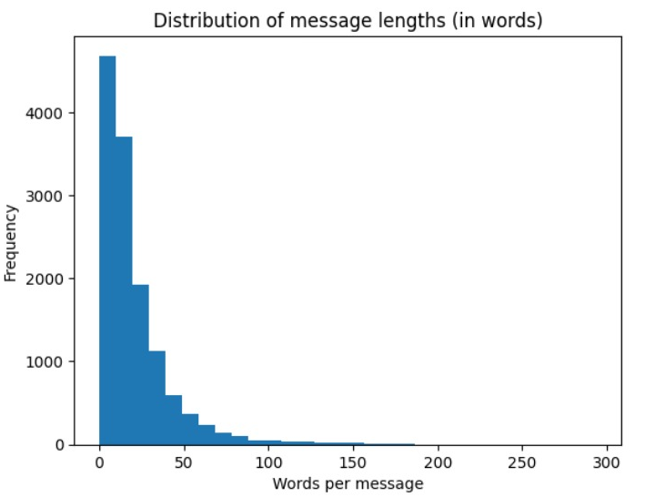
Dataset description
Source and Format:
Data is provided in JSONL files (train.jsonl, validation.jsonl, test.jsonl) containing diplomatic messages from the game Diplomacy.
Features:
Text messages exchanged between players (covering negotiation and strategic discussions).
Binary labels indicating truth (0) or lie (1).
Metadata includes speaker, receiver, game ID, season, year, game scores, and message indices.
Data Splits:
Training: 13,132 samples
Validation: 1,416 samples
Test: 2,741 samples
Label Distribution:
Majority class (Truth, 0): ~70% of training data.
Minority class (Lie, 1): ~30% of training data.
Imbalance implies a risk of model bias toward the truthful class.
Text Characteristics:
Average message length: 20.66 words.
Median message length: 14 words.
Maximum message length: 294 words (indicating a long-tail distribution).
Most messages are under 50 words

Slide 5
Methodology
Preprocessing Pipeline
Original Format: JSONL files (train.jsonl, valid.jsonl, test.jsonl)
Converted To: CSV format (train.csv, val.csv, test.csv) for easier handling and model input
Steps:
Null value removal
Duplicate elimination
Standardization of categorical variables
Feature extraction: text + 12 engineered metadata features
Text Cleaning: Lowercased, removed non-alphanumeric characters
Final Dataset Sizes:
Train: 17,915 samples → Balanced to 25,082 (via oversampling)
Validation: 1,416 samples
Test: 2,741 samples
Class Balance (Post-Oversampling):
50% Truthful (12,541)
50% Deceptive (12,541)
2. Baseline Modeling Approaches
Classical ML Models Used:
Logistic Regression
Random Forest
Naive Bayes
Support Vector Machines (SVM)
Feature Sets Evaluated:
Text-only: TF-IDF vectorization
Metadata-only: 12 features (e.g., message_length, game_stage, sender_is_player)
Combined: TF-IDF + metadata
3. Baseline Results Summary
Best Performing Baseline:
Random Forest achieved 91.24% accuracy
Major Limitation:
High nominal accuracy due to skewed data
Failed to detect deceptive messages (predicted all as truthful)
Confusion matrix showed 0 predictions for deceptive class

Slide 6
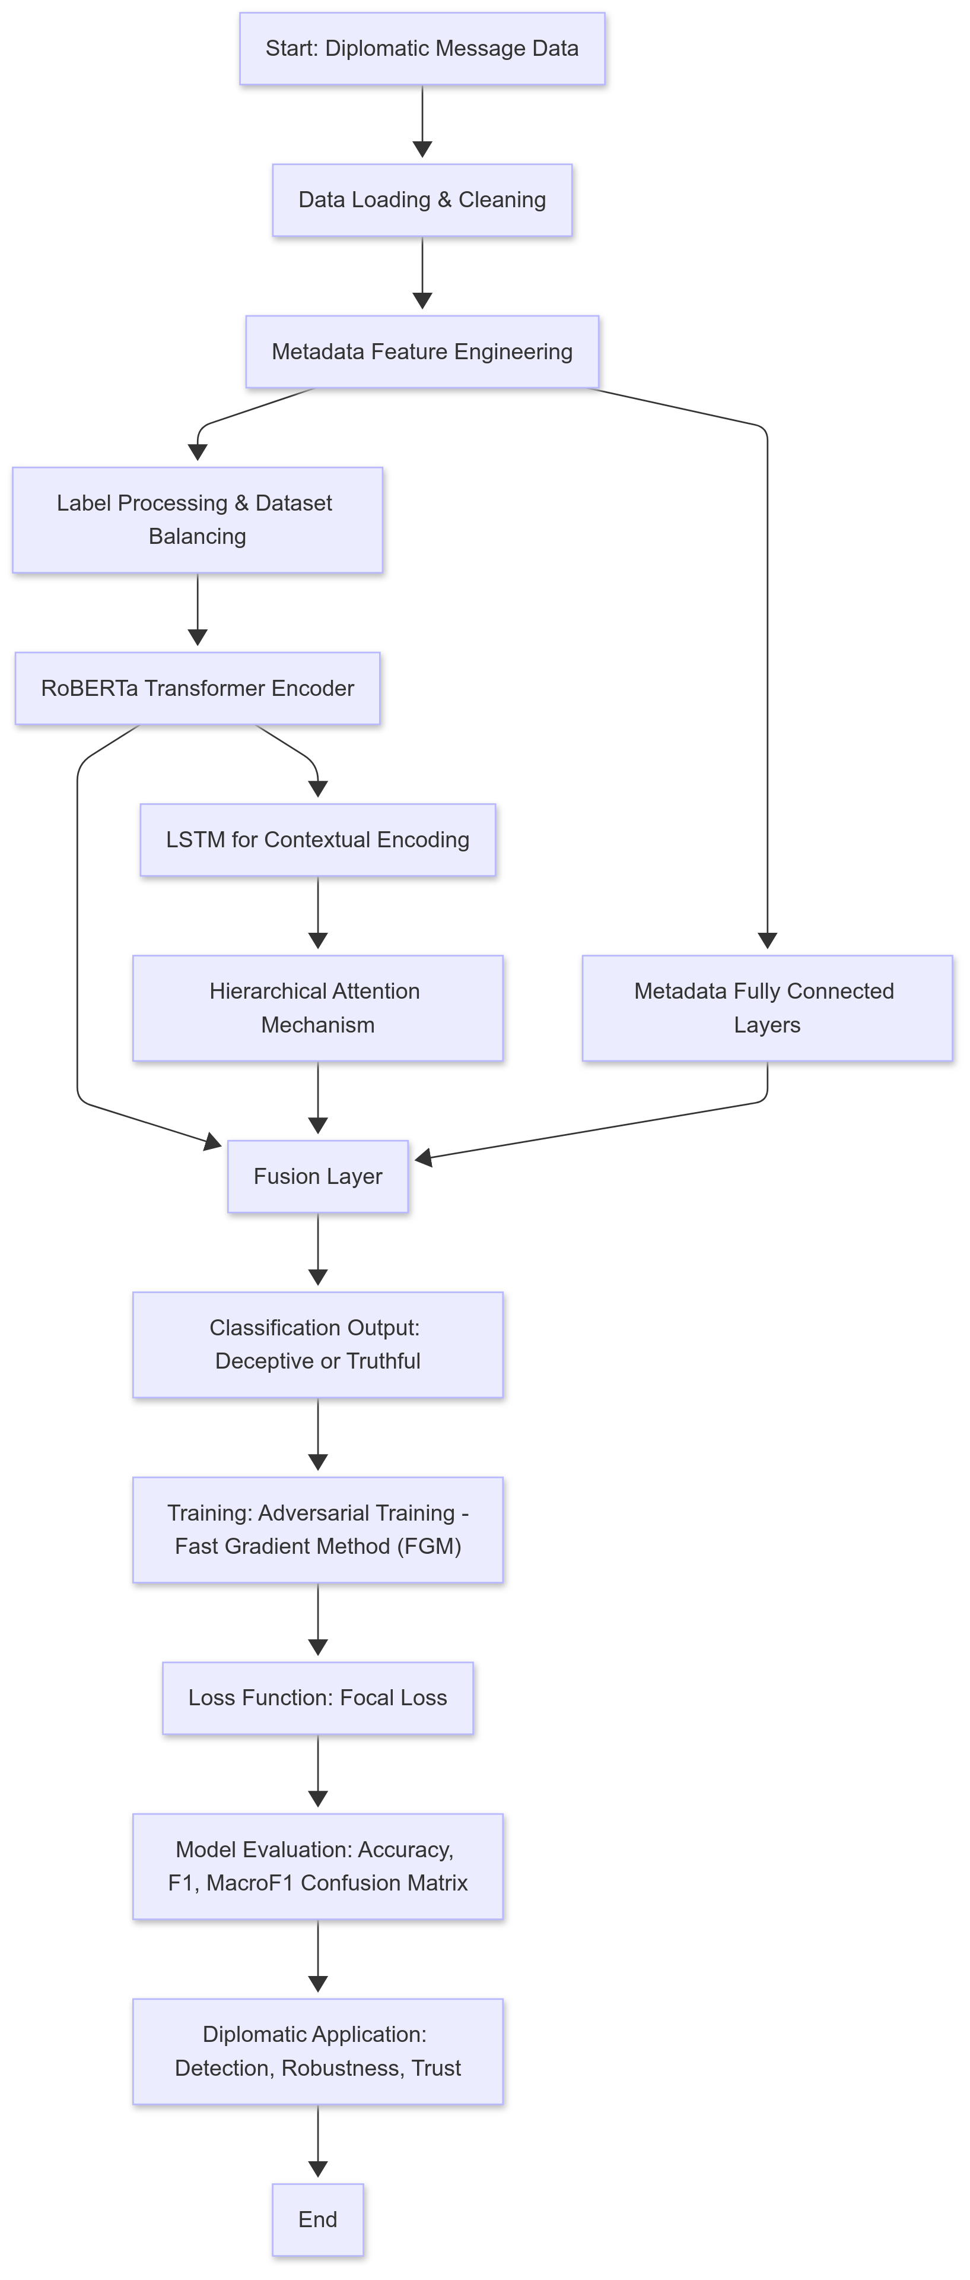
Methodology
Dataset Construction and Tokenization
Custom Dataset Implementation:
Use a hierarchical dataset class to load and structure the data.
Tokenize the current message using the RoBERTa tokenizer.
Tokenize each context message separately, enforcing fixed sequence lengths and a fixed number of context messages.
Convert engineered metadata into tensors for integration.
Optional Data Augmentation:
Optionally apply augmentation (e.g., random lowercasing) to enhance text diversity during training.
Model Architecture
Text Encoding:
Utilize a pre-trained RoBERTa model to convert current message text (and context messages) into dense embeddings.
Extract the [CLS] token as a summary representation.
Context Modeling:
Process context messages using a bidirectional LSTM with hierarchical attention and multi-head attention to capture temporal dependencies.
Generate a weighted context vector that emphasizes salient parts of the conversation.
Metadata Processing:
Process metadata through a dedicated feed-forward network (with optional attention) to create a dense metadata representation.
Fusion and Output:
Concatenate text, aggregated context, and metadata representations.
Pass the fused vector through fully connected layers with non-linear activations and dropout to produce a single logit for binary classification.

Slide 7
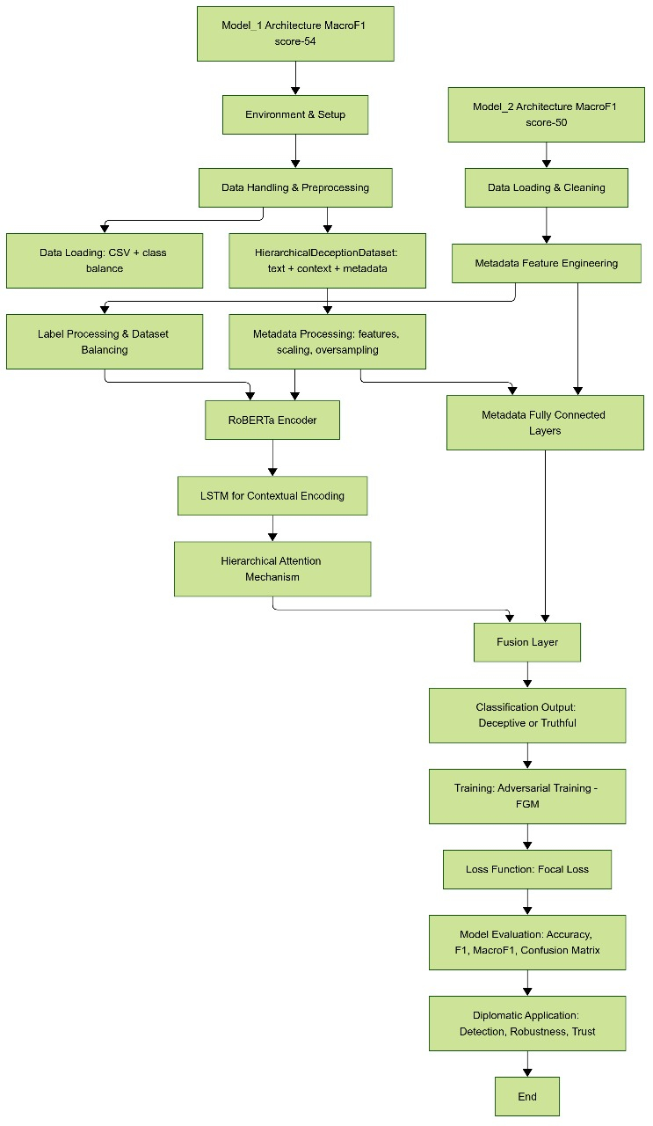
Methodology
Training Strategy
Loss Function:
Employ Focal Loss (with parameters such as alpha = 3.0 and gamma = 2) to down-weight easy examples and focus on harder, misclassified ones.
Adversarial Training (FGM):
Integrate adversarial training by perturbing embeddings using FGM and combining adversarial loss with the standard loss to boost model robustness.
Optimization & Scheduling:
Use AdamW optimizer (with weight decay) combined with a OneCycleLR scheduler for dynamic learning rate adjustment.
Early Stopping:
Implement early stopping based on improvements in validation macro-F1 score (with a defined patience) to prevent overfitting.
Evaluation Pipeline
Metrics:
Evaluate using metrics such as Accuracy, Precision, Recall, F1 Score, and Macro F1 Score.
Compute confusion matrices to analyze class-specific performance.
Visualization:
Plot and save training curves (loss, accuracy, and macro-F1) for both training and validation phases.
Model Saving:
Save the best model checkpoint and tokenizer for future inference.

Slide 8
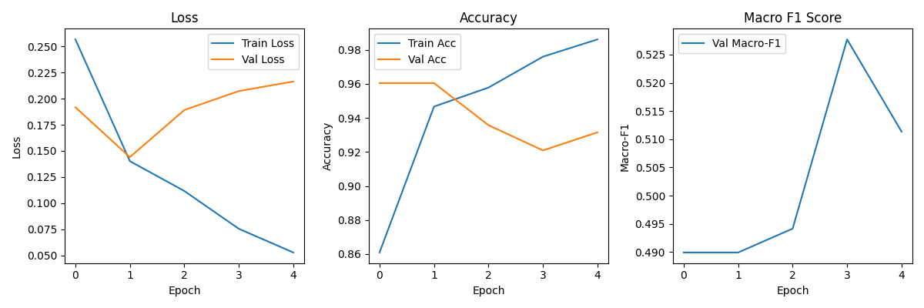
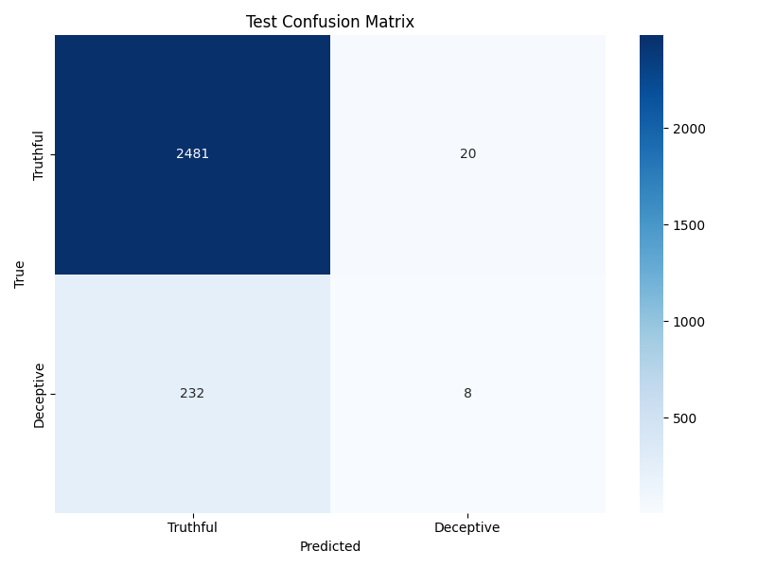
Results/Analysis
Training Metrics:
Training accuracy approaching 98–99% with progressively lower training loss.
Validation macro-F1 peaked around 0.5277 before plateauing.
Test Set Performance:
Models | Parameters | Precision | Recall | Accuracy | F1 Score | MicroF1 score
Model_1 | Roberta + Hierarchical + LSTM | 20.71% | 12.08% | 88.25% | 15.26% | 54.48%
Model_2 | Hierarchical Attention + context+ FGM) | 28.57% | 03.33% | 90.81% | 05.97% | 50.57%
Model_3 | Multihead Attention + context + hierarchical_lstm | 91.76% | 95.68% | 88.22% | 93.68% | 53.54%
Model_3 Multihead_attention + context+ Hierarchical LSTM

Slide 9
Conclusion
Model_1
Decent accuracy & macro F1
Weak performance on minority class (low precision/recall
Model_2
High accuracy
Very low recall on minority class (almost missing all deceptive cases)
Most conservative — very few false positives but misses most actual deception
Model_3
Outstanding performance on the minority (positive/deceptive) class
Somewhat aggressive — large number of false positives
Might be overpredicting deception
Model 3 is the best if our primary goal is to detect deception as it finds almost all deceptive instances (very high recall) with strong precision and F1, making it ideal in high-stakes or safety-critical scenarios where missing a deceptive instance is worse than a false alarm. If we need to balance false positives and false negatives more conservatively then Model 1 is a middle-ground. Model 2 is despite highest accuracy is least helpful for deception detection due to its very low recall.
Hierarchical approach effectively integrates text, context, and metadata.
Robust training pipeline with focal loss and adversarial methods yields high overall accuracy.
Current gap in detecting the minority deceptive class highlighted by lower macro-F1.

Slide 10
Future work
Future Work:
Multi-modal Learning: Integrating additional modalities (e.g., game board states, player strategies) could further enhance performance.
Ensemble Methods: Combining strengths from different architectures might yield better-balanced performance.
Interactive Systems: Developing a real-time feedback loop with human evaluators could provide data for continuous model improvement.
Threshold Optimization: Advanced techniques for threshold calibration could better balance precision and recall for the deceptive class.

Slide 11
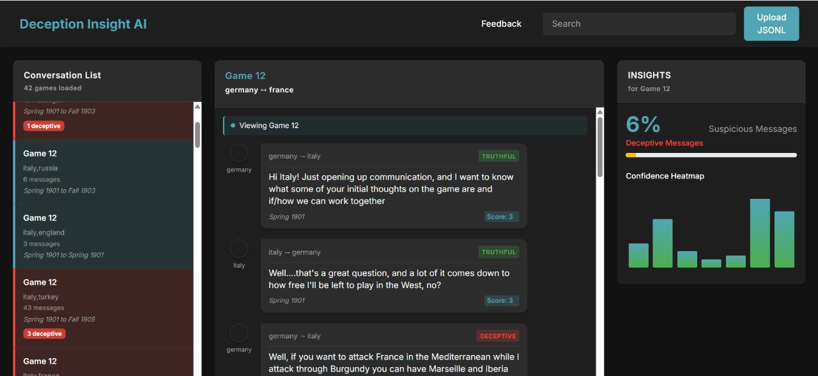
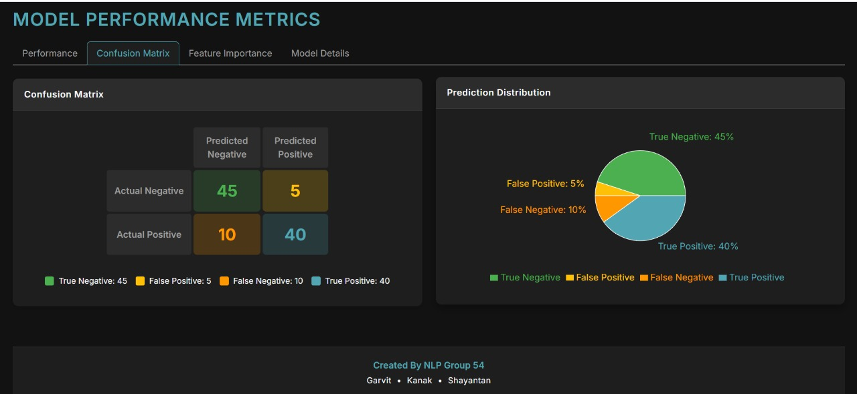
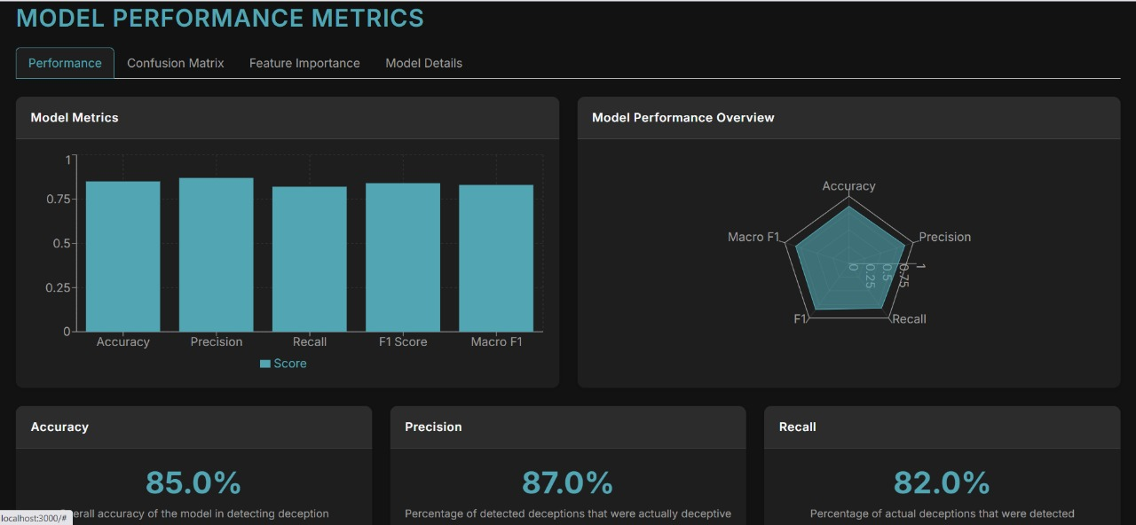
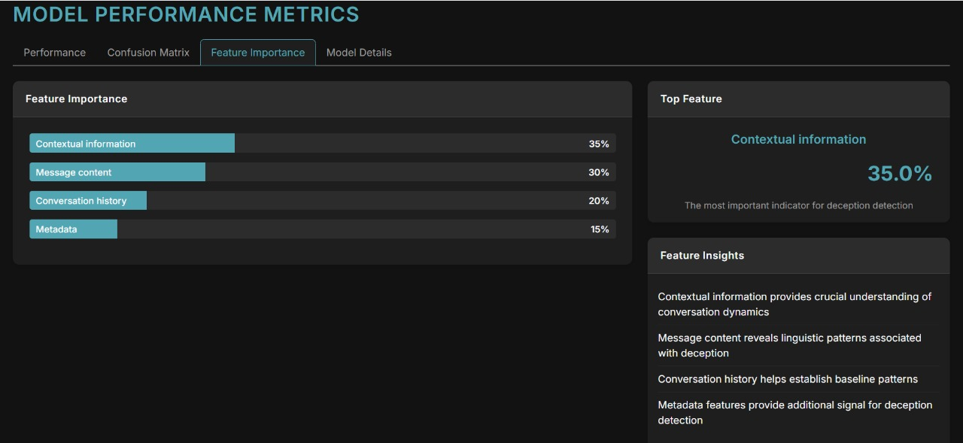
Fronted for the Diplomacy Deception Game
Thank YOU ☺

